Slide 1

Smart Shield
Stay Connected, Stay Protected!
Hackathon Project
Team Members
Chandu Pranav Nithin

Slide 2
The Problem
🔴 Public Wi-Fi is unsafe
🔴 Users don’t realize the risks
⚠️ Major Threats:
- MITM Attacks
- Fake Wi-Fi Networks
- Unencrypted Traffic

Slide 3
Our Solution – Smart Shield
✅ Automatically scans Wi-Fi security
✅ Warns users about risks
✅ Suggests VPN connection

Slide 4
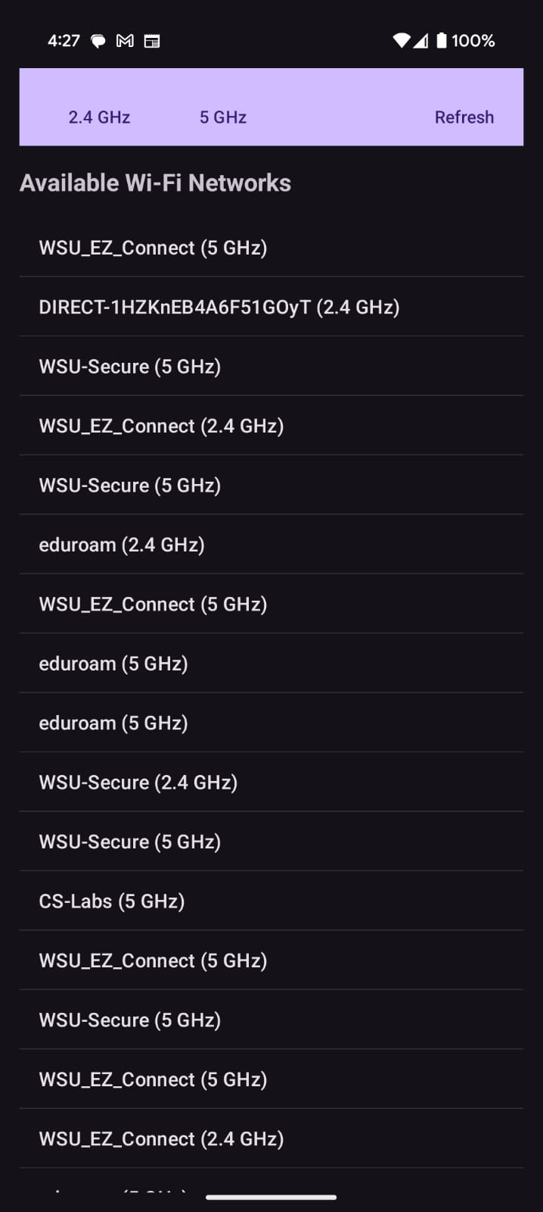
How Smart Shield Works
📌 1. User connects to Wi-Fi
📌 2. SmartShield scans network security
📌 3. Displays risk level (Safe/Medium/High)
📌 4. Suggests VPN & redirects user
📌 5. Confirms secure connection

Slide 5
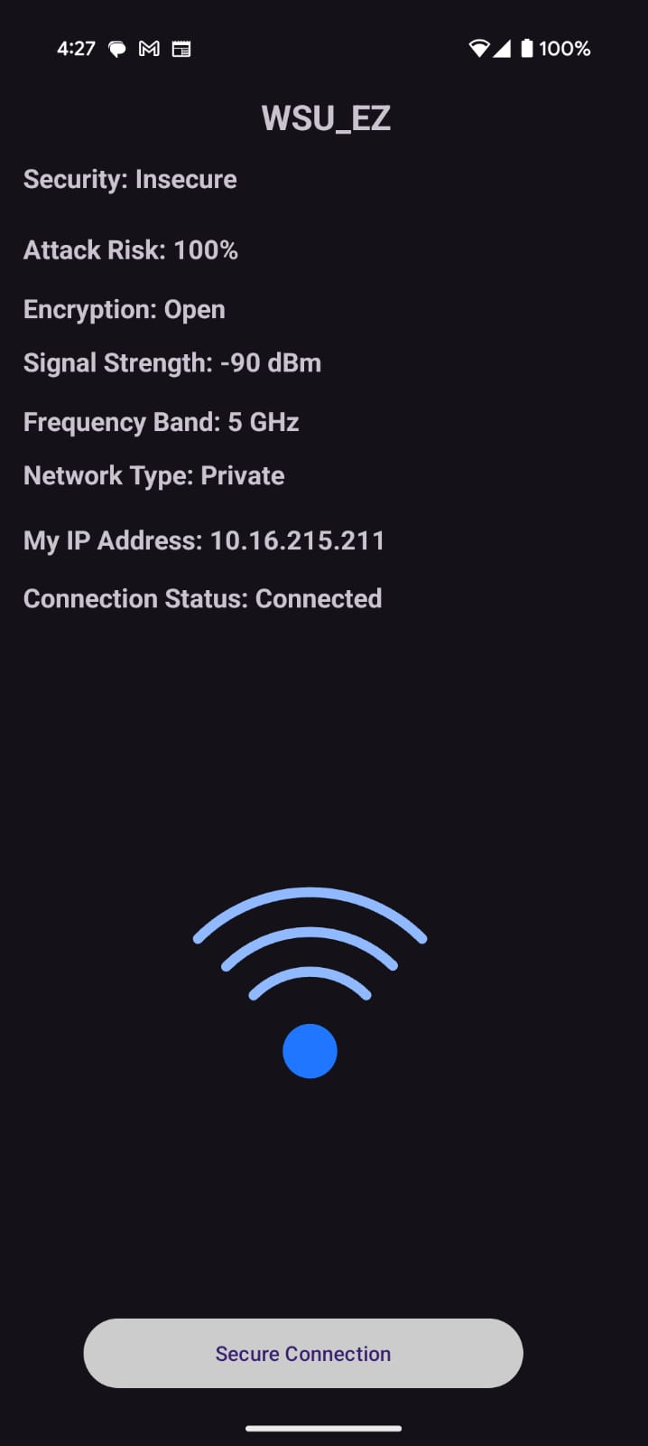
Key Features
✔️ Wi-Fi Security Check
✔️ Risk Level Indicator
✔️ Auto VPN Suggestion
✔️ Secure Connection Confirmation

Slide 6
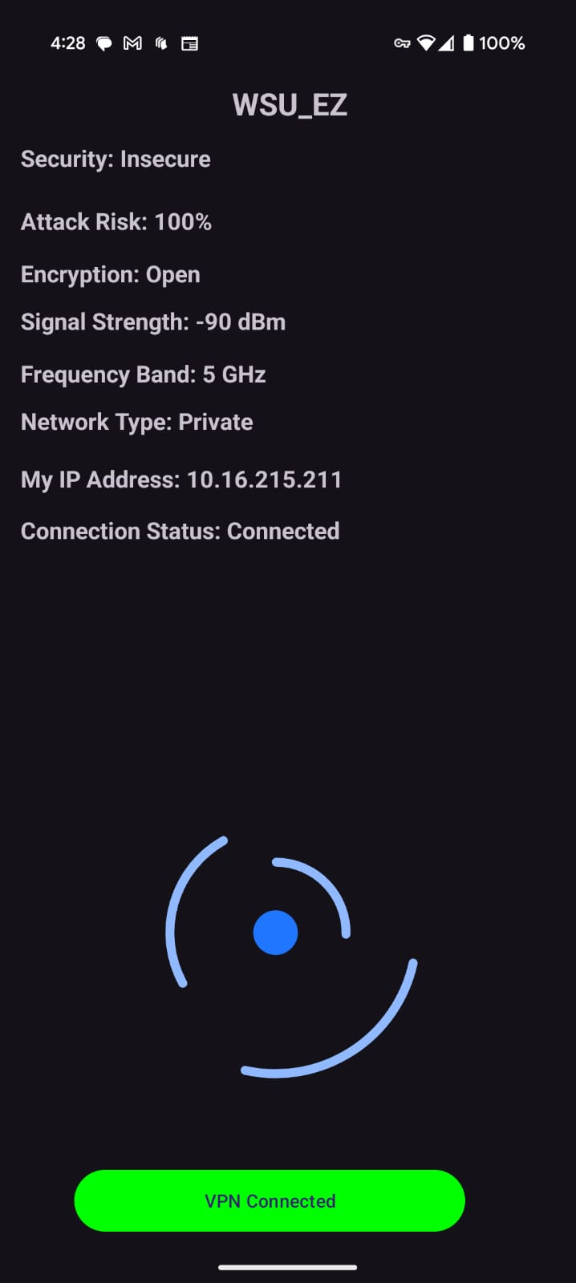
Technology Stack
🛠️ Android Studio (java)
🛠️ Wi-Fi Analyzer, VPN Detection
🛠️ Detection Methods:
- No Encryption Warning
- Weak Encryption Alert

Slide 7
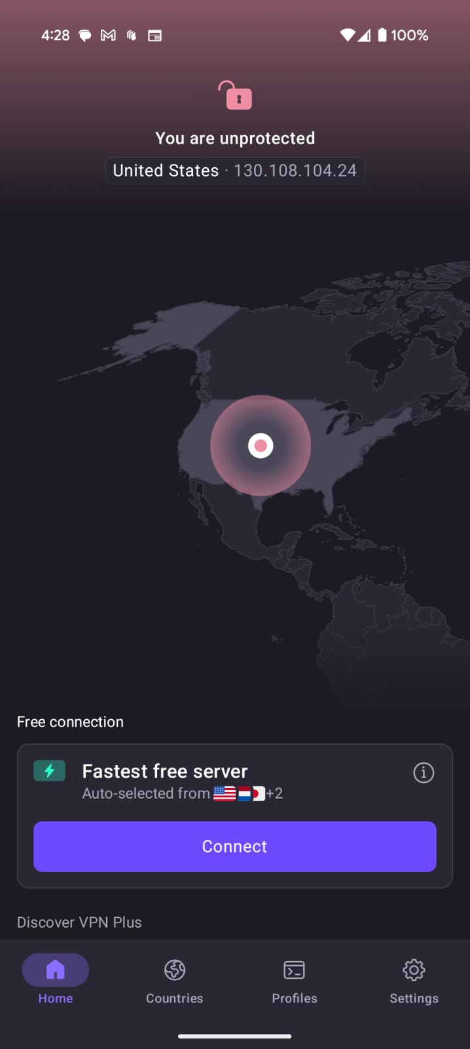
Future Enhancements
🔮 Auto-connect to preferred VPN
🔮 AI-based risk detection
🔮 Support for enterprise VPNs

Slide 8
Challenges & Solutions
❌ Detecting well-disguised threats → ✅ Network behavior analysis
❌ User adoption → ✅ Simple & seamless UI
❌ VPN compatibility issues → ✅ Support all installed VPNs

Slide 9
Why Smart Shield?
🔥 Easy-to-use, automatic security
🔥 Works with any VPN, no subscriptions
🔥 Provides instant risk analysis & protection

Slide 10
Conclusion & Q&A
🔹 SmartShield makes public Wi-Fi safer
🔹 Innovative & necessary solution
🔹 Questions?

